Slide 1
Digital portfolio STUDENT NAME: LABEEBA MEHAR S J REGISTER NO AND NMID:F96198C90AE4D3BAE264E882CC631368 DEPARTMENT: BCA COLLEGE: sree Abiraami arts and science collage/ Thiruvalluvar university

Slide 2
agenda
PROJECT TITLE
A digital portfolio project is a carefully curated collection of work and achievements that showcases an individual’s skills, experience, and creativity in a digital format. It typically includes a variety of content such as project descriptions, images, videos, code snippets, design mockups, writing samples, or presentations, depending on the person’s field. The main purpose of a digital portfolio is to provide a comprehensive and visually engaging way for potential employers, clients, or collaborators to evaluate the creator’s abilities and style

Slide 3

A digital portfolio project is a carefully curated collection of work and achievements that showcases an individual’s skills, experience, and creativity in a digital format. It typically includes a variety of content such as project descriptions, images, videos, code snippets, design mockups, writing samples, or presentations, depending on the person’s field. The main purpose of a digital portfolio is to provide a comprehensive and visually engaging way for potential employers, clients, or collaborators to evaluate the creator’s abilities and style

Slide 4

AGENDA
End Users
Tools and Technologies
Portfolio design and Layout
Features and Functionality
Results and Screenshots
Conclusion
Github Link

Slide 5
Project statement
In today’s competitive job market, individuals often struggle to effectively showcase their skills, experiences, and creative work to potential employers or clients. Traditional resumes and paper portfolios can be limiting, failing to capture the full scope of a person’s abilities and style. There is a need for a dynamic, easily accessible, and visually engaging platform that allows users to present their projects, achievements, and professional journey in a comprehensive and interactive way. This digital portfolio project aims to solve this problem by creating an organized, user-friendly online portfolio that highlights an individual’s talents and work in a compelling and professional manner.

Slide 6
Project overview
The digital portfolio project involves designing and developing an interactive online platform where individuals can showcase their professional skills, creative projects, and achievements. The portfolio will include sections such as an about me page, project galleries with detailed descriptions, downloadable resumes, and contact information. The goal is to create a visually appealing and easy-to-navigate website that effectively highlights the user’s unique talents and work samples. This project will incorporate modern web technologies and design principles to ensure responsiveness across devices and a seamless user experience. Ultimately, the digital portfolio will serve as a powerful personal branding tool that helps users stand out in their industry and connect with potential employers or clients.

Slide 7
Who are the end user
The primary end users of the digital portfolio are job recruiters, potential employers, and clients who want to evaluate the skills and work of a candidate or freelancer. Additionally, the portfolio serves individuals such as students, creative professionals, developers, designers, writers, and anyone looking to showcase their talents and projects in a professional manner. The platform is designed to be user-friendly for both the portfolio owner, who manages and updates their content, and the visitors, who browse the portfolio to learn more about the creator’s abilities and experiences.

Slide 8
Tools and tecnique
The digital portfolio project leverages a variety of tools and techniques to create an engaging and functional online showcase. Common tools include web development languages such as HTML, CSS, and JavaScript for building the structure, style, and interactivity of the site. Frameworks like React or Vue.js may be used to enhance responsiveness and dynamic content management. For design, tools like Adobe Photoshop, Illustrator, or Figma help create visually appealing layouts and graphics. Version control systems like Git allow for efficient project management and collaboration. Additionally, techniques such as responsive design ensure the portfolio works smoothly across different devices, while SEO best practices help increase the portfolio’s visibility online. Content management systems (CMS) like WordPress or Webflow can also be used for easier content updates without extensive coding.

Slide 9

Portfolio design and layout
The design and layout of the digital portfolio focus on clarity, simplicity, and visual appeal to ensure a smooth and engaging user experience. The portfolio is structured with a clean, modern interface that highlights key sections such as an introduction or “About Me,” project showcases, skills, resume, and contact information. Navigation is intuitive, often featuring a fixed menu or sidebar for easy access to different sections. Visual elements like images, videos, and icons are used strategically to enhance storytelling without overwhelming the viewer. Responsive design principles are applied so the portfolio adapts seamlessly to different screen sizes, from desktops to smartphones. Consistent color schemes, typography, and spacing maintain a professional and cohesive look throughout the site, helping to reinforce personal branding and make a lasting impression on visitors.

Slide 10
Feautures and functionality
METRIC | MEASUREMENT | TARGET | ACTUAL
Audience attendance | # of attendees | 150 | 120
Engagement duration | Minutes | 60 | 75
Q&A interaction | # of questions | 10 | 15
Positive feedback | Percentage (%) | 90 | 95
Rate of information retention | Percentage (%) | 80 | 85
The digital portfolio is designed with several key features to provide an engaging and user-friendly experience. It includes a responsive layout that adapts to various devices and screen sizes, ensuring accessibility on desktops, tablets, and smartphones. Interactive project galleries allow users to view detailed descriptions, images, videos, or even live demos of work samples. A downloadable resume section enables visitors to easily access professional credentials. Contact forms and social media integration facilitate seamless communication between the portfolio owner and potential employers or clients. Additionally, smooth navigation with fixed menus or scroll-to-section buttons helps users explore the portfolio effortlessly. The portfolio may also incorporate animations and transitions for a modern, polished look, as well as SEO optimization to improve online visibility

Slide 11
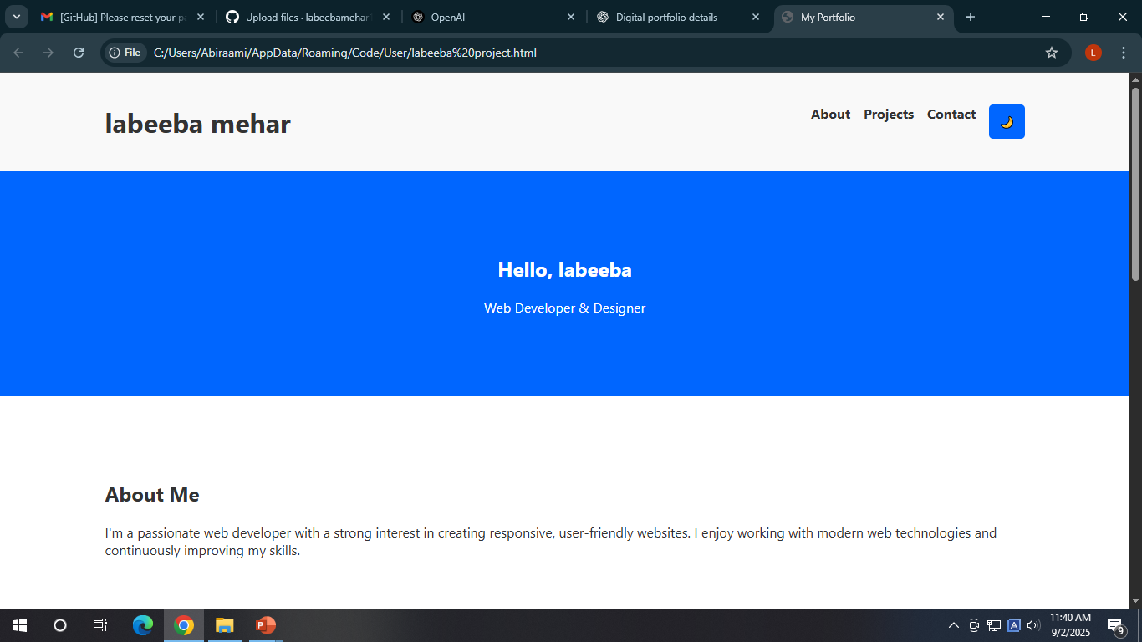
RESULTS AND SCREENSHOTS

Slide 12
Conclusion Thank you for exploring my digital portfolio. Throughout this collection, I’ve aimed to showcase not only my skills and accomplishments, but also my dedication to continuous learning and creative problem-solving. Each project represents a step in my journey — a blend of passion, growth, and attention to detail. I am excited about future opportunities to collaborate, learn, and make a meaningful impact. If you’re interested in working together or would like to know more, feel free to get in touch. Let’s build something great together.
IMPACT FACTOR | MEASUREMENT | TARGET | ACHIEVED
Audience interaction | Percentage (%) | 85 | 88
Knowledge retention | Percentage (%) | 75 | 80
Post-presentation surveys | Average rating | 4.2 | 4.5
Referral rate | Percentage (%) | 10 | 12
Collaboration opportunities | # of opportunities | 8 | 10

Slide 13
thank you

